Slide 1
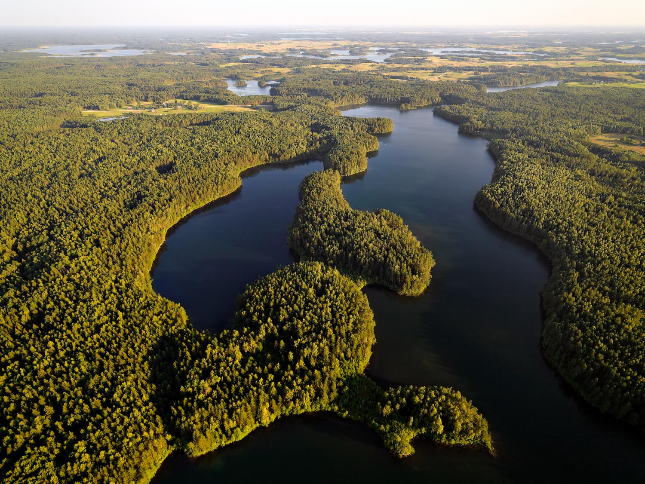
Lithuania
The country of beautiful landscape and great history

Slide 2
Comenius Multilateral Project
LERBISH
Lithuania, Varėna

Slide 3
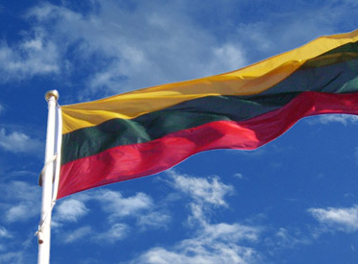
Lithuanian flag
Yellow colour means sun
Green colour means Lithuanian nature
Red colour means lithuanians shed blood

Slide 4
This is Lithuanian coat of arms. It is called Vytis.

Slide 5
President of Lithuania - Dalia Grybauskaitė

Slide 6
Lithuania capital city - Vilnius

Slide 7
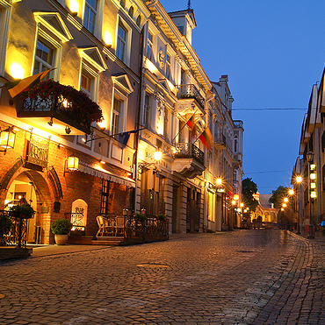
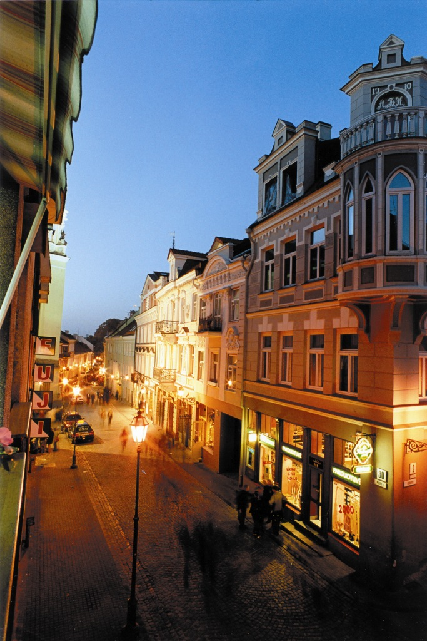
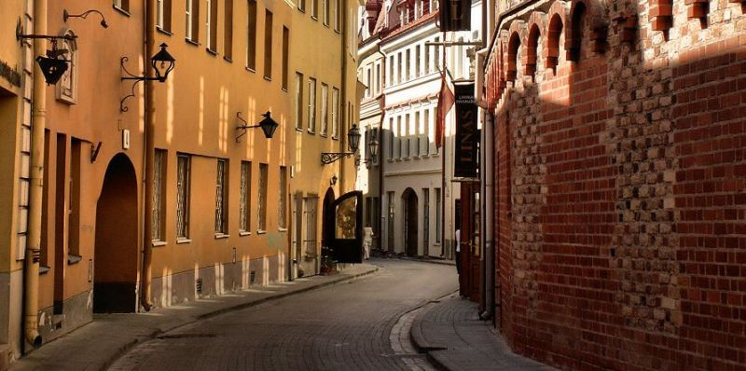
there is amazing old town in Vilnius

Slide 8
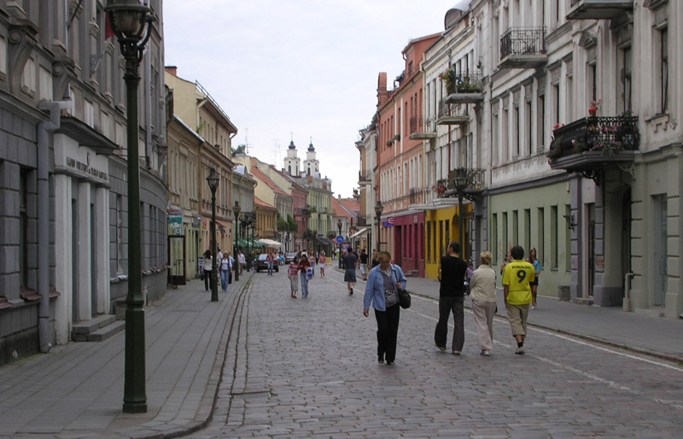
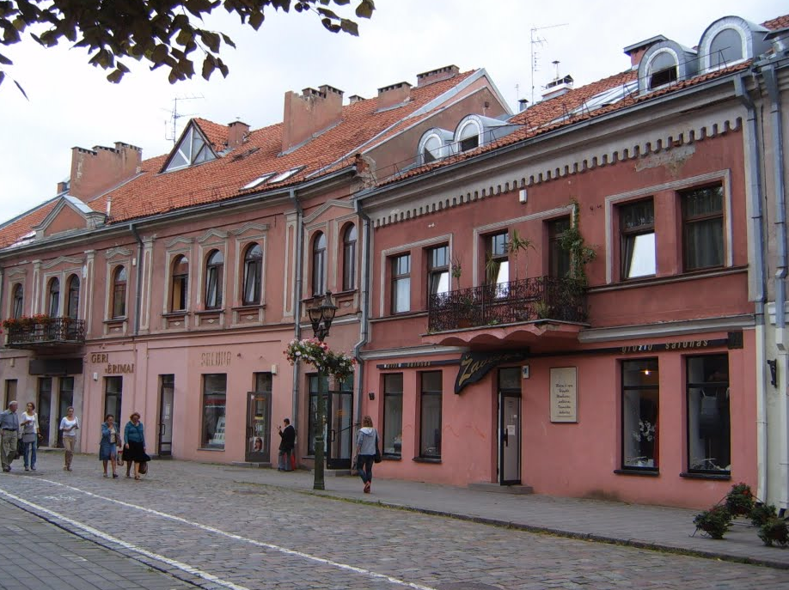
And in Kaunas too!

Slide 9
Here you can see the Lithuanian folk clothes

Slide 10
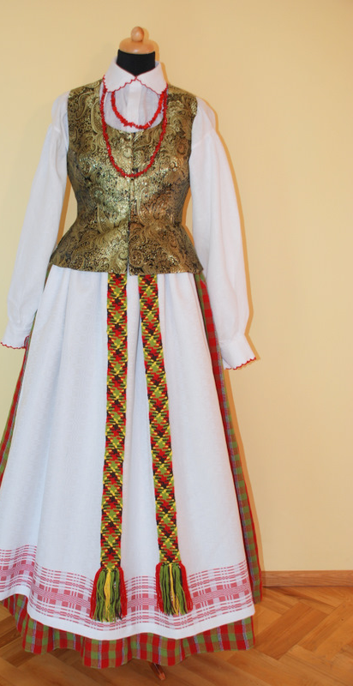
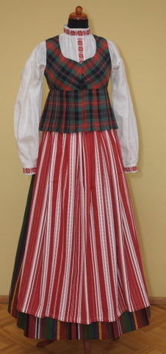
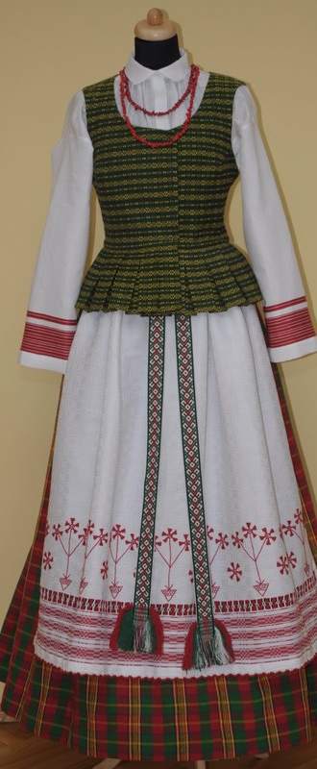

Slide 11
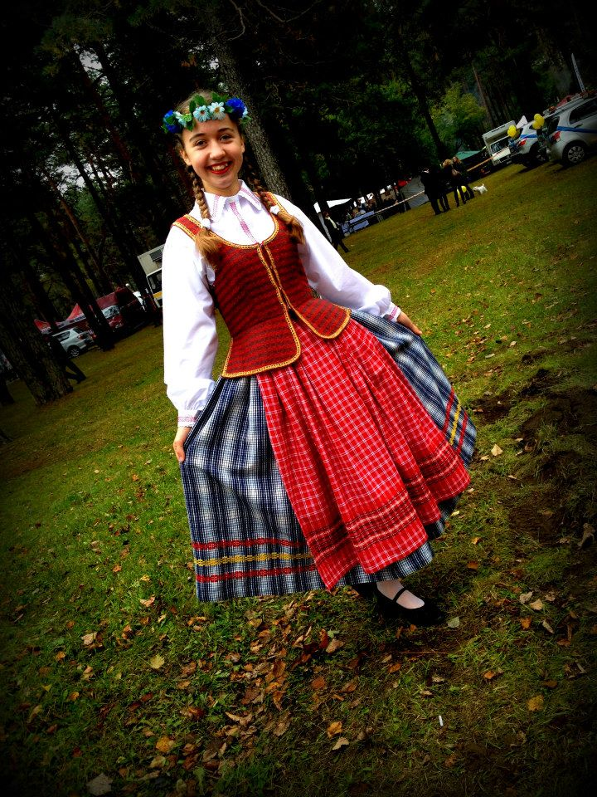
Our Greta dressed
up with lithuanian
folk clothes ☺

Slide 12
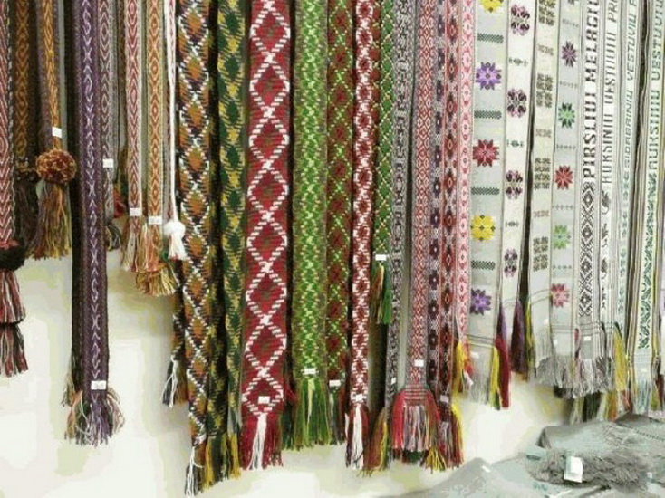
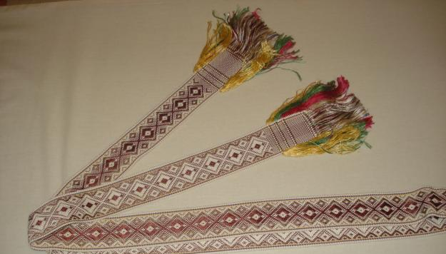
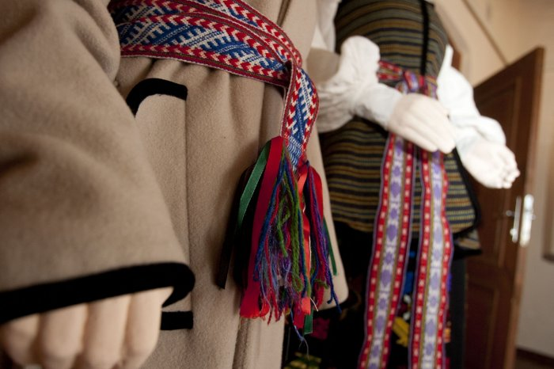
A very important part of the Lithuanian folk dress - a colorful band

Slide 13
There are about 30 000 lakes and rivers in Lithuania

Slide 14
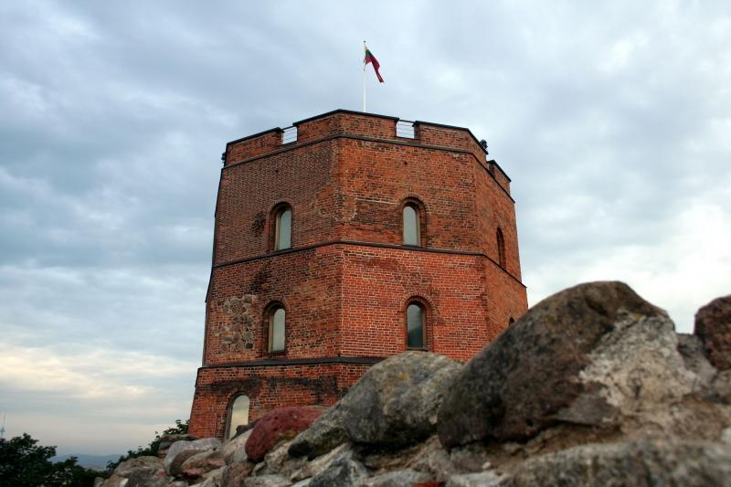
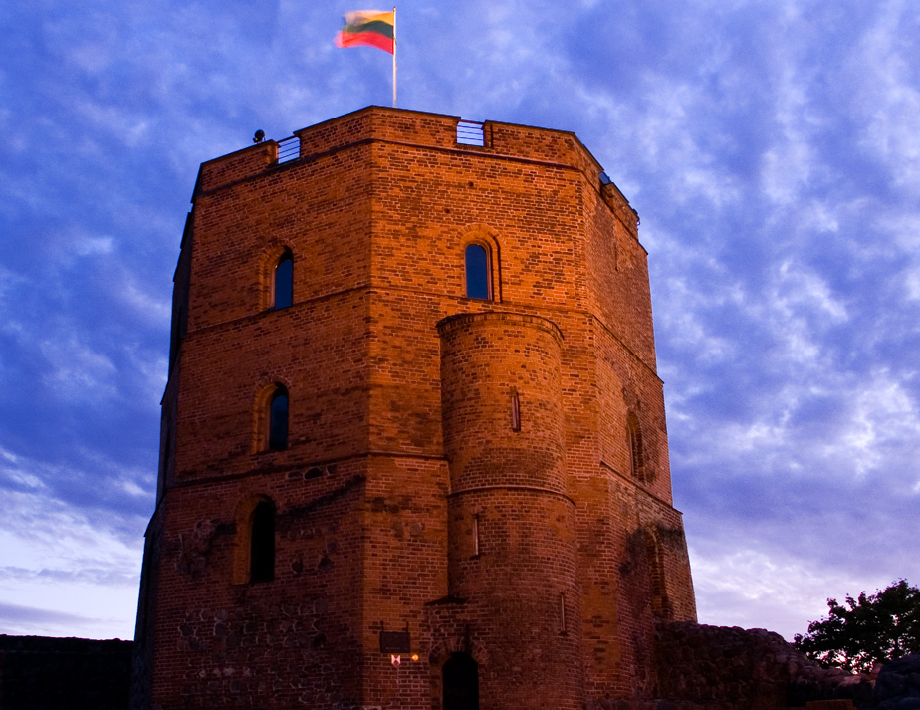
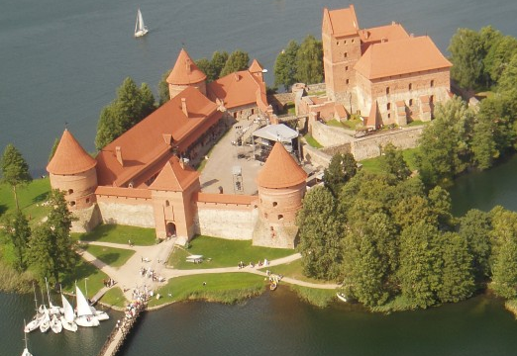
Lithuanian castles are cord surrounded by impressive legends

Slide 15
Gediminas Hill

Slide 16
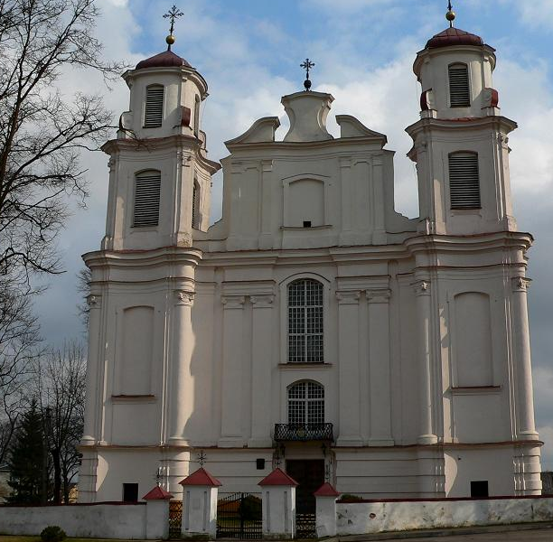
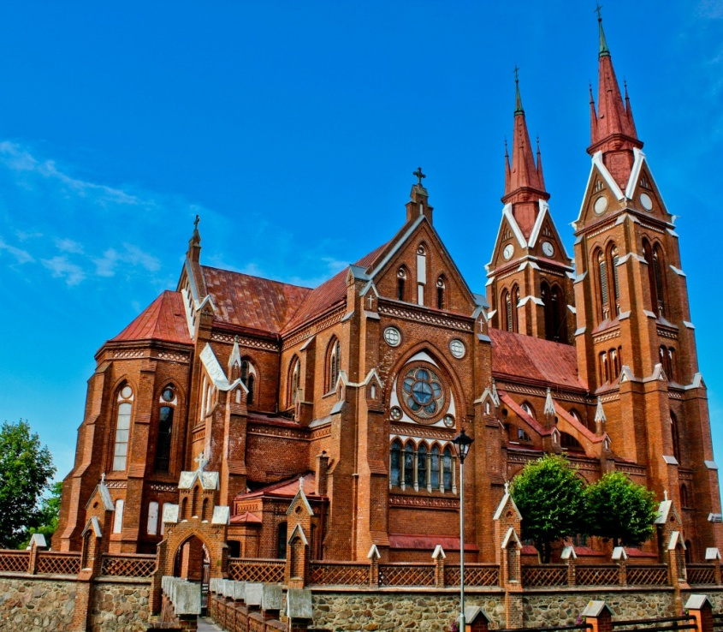
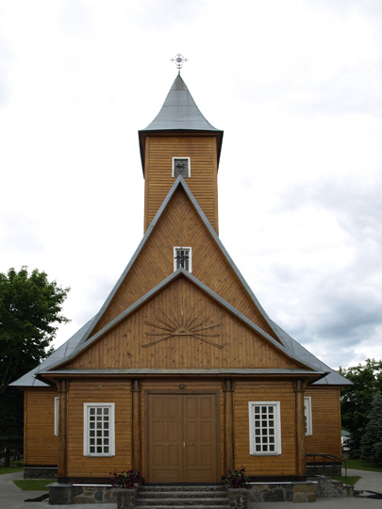
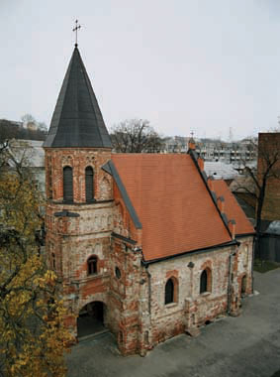
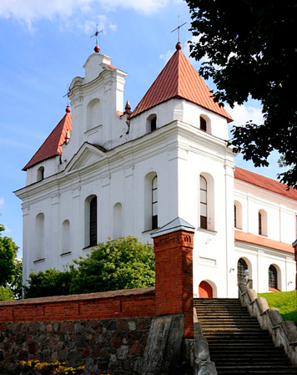
Lithuania has many beautiful churches

Slide 18
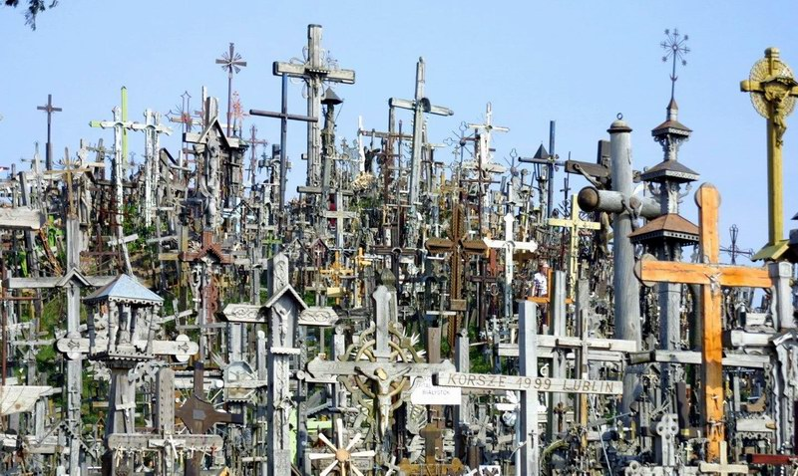
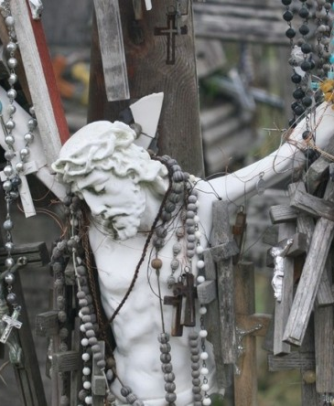
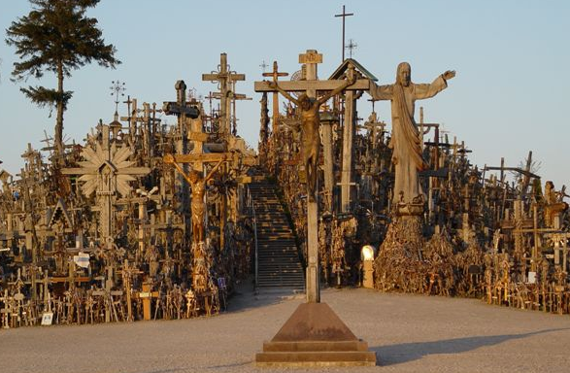
Hill of Crosses

Slide 19
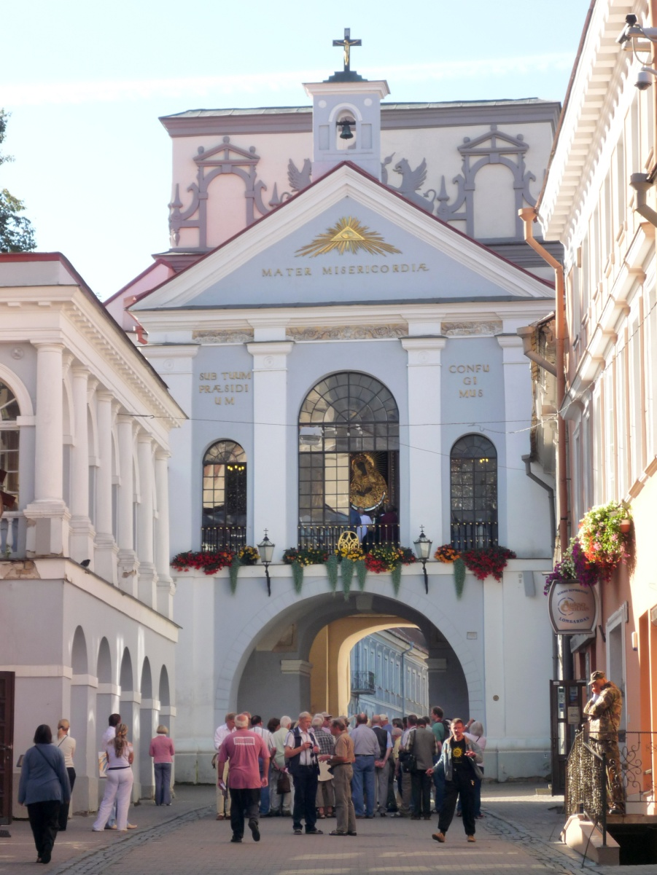
Down gate

Slide 20
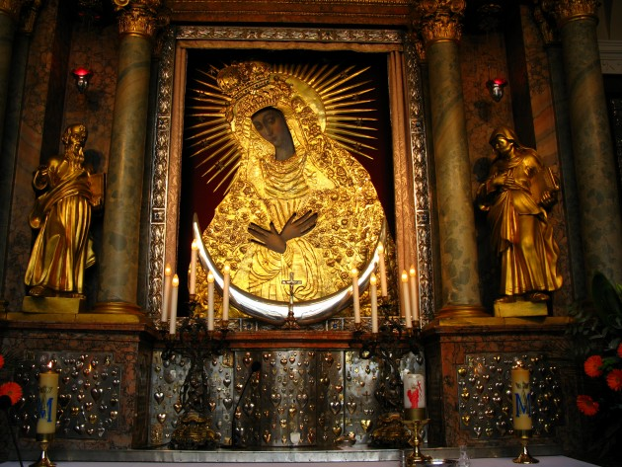
Holy Mary painting

Slide 21
Historical personalities

Slide 22
Lithuanian anthem

Slide 23
Lithuanian dishes

Slide 24
Cepelinai

Slide 27
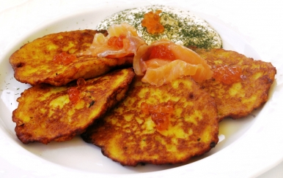
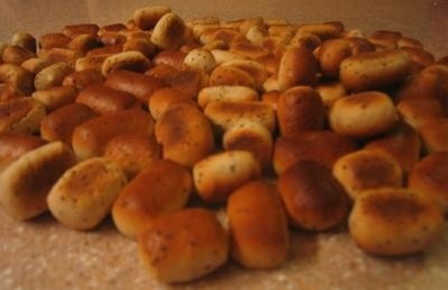
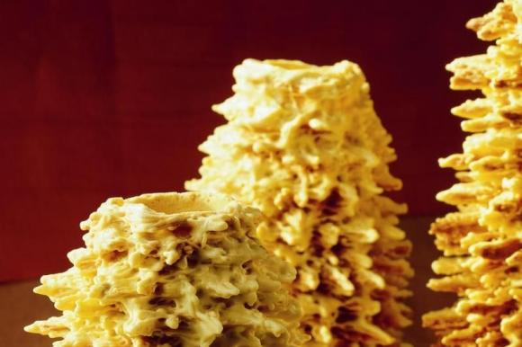
Looks tasty, isn’t it?

Slide 28
Lithuanian gold - Amber

Slide 29
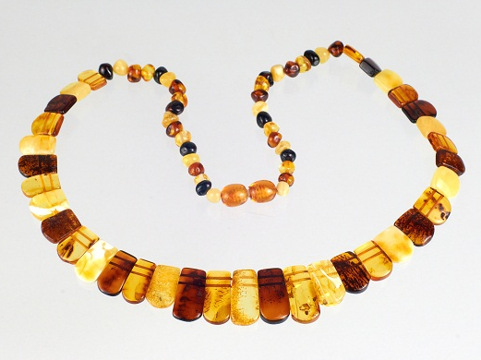
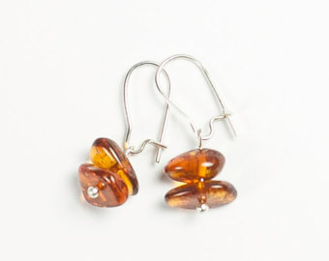
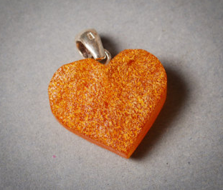
Amber jewelry

Slide 30
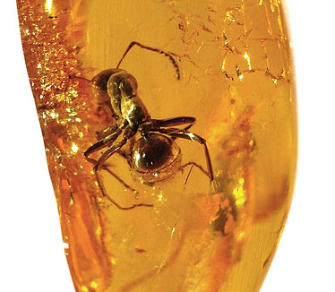
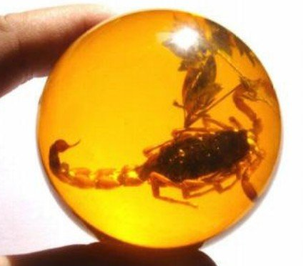
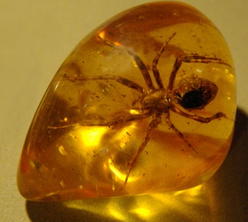
Amber incluses

Slide 33
Made by :
Vytė Masteikaitė
Milita Naujalytė
Greta Petrovaitė

