Slide 1
Joninės(Dew Holliday)
It is a midsummer folk festival celebrated on June 24 all around Lithuania.

Slide 2
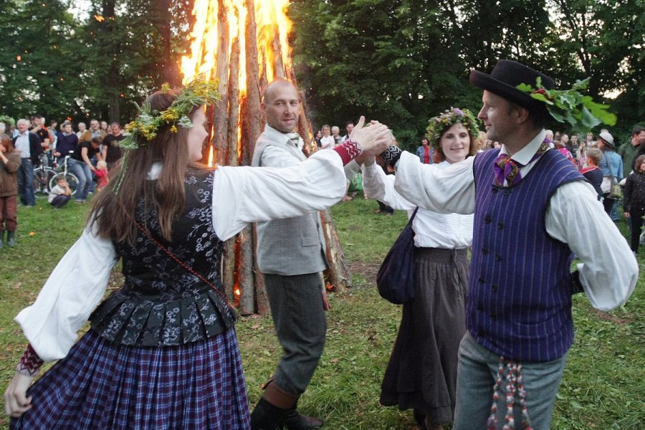
Most of the participants in the festival usually arrive dressed in national costumes and wearing grass wreaths.

Slide 3
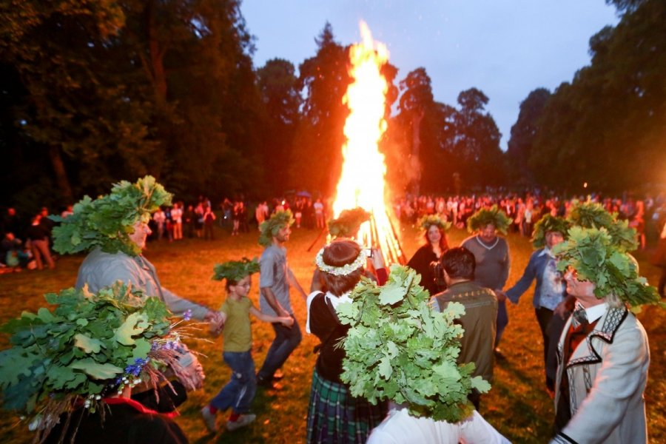
TRADITIONS
Singing songs and dancing until the sun sets.

Slide 4
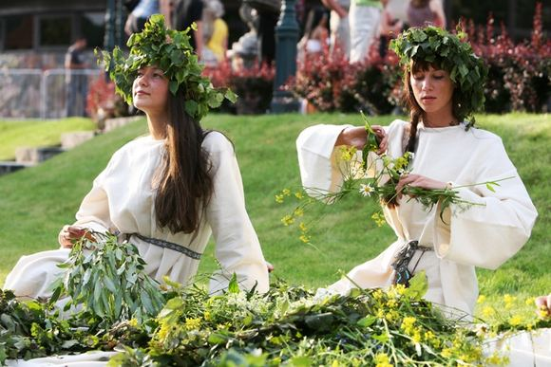
Telling tales

Slide 5
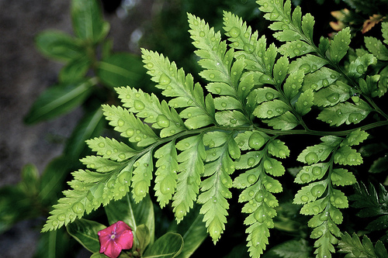
Searching to find the magic fern blossom at midnight.

Slide 6
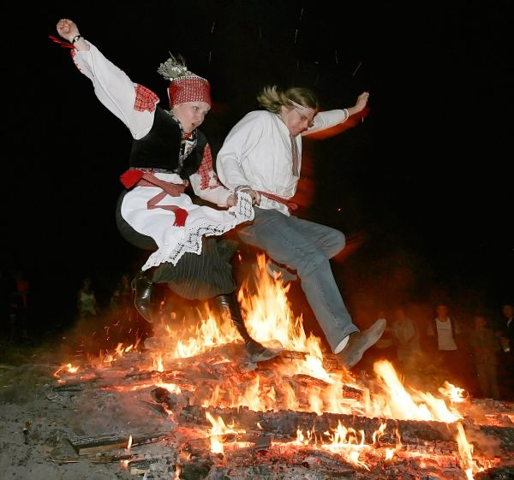
Jumping over bonfires

Slide 7
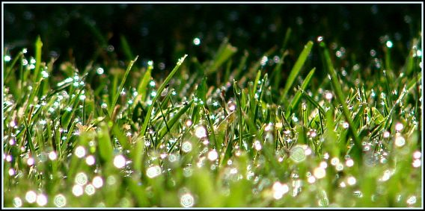
Greeting the rising midsummer sun and washing the face with a morning dew.

Slide 8
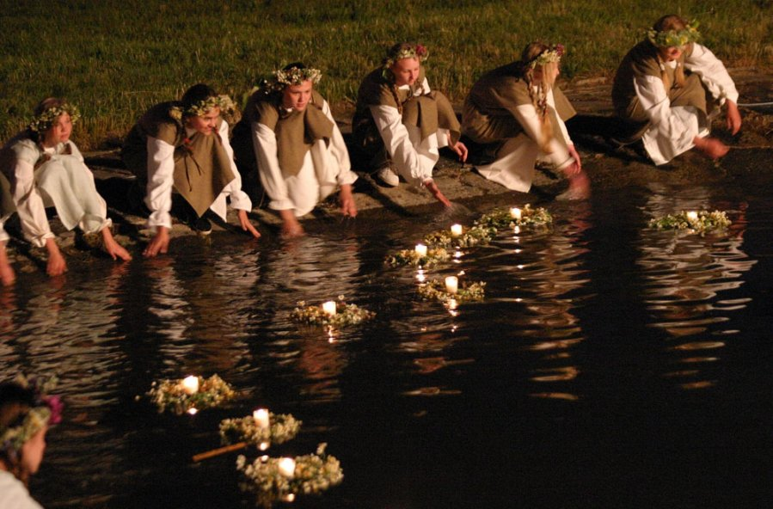
Young girls float flower wreaths on the water of river or lake.

Slide 9
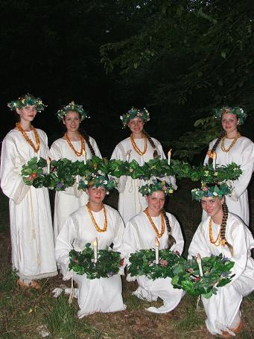
These are customs brought from pagan culture and beliefs.

Slide 10
The latter Christian tradition is based on the reverence of Saint John the Baptist.
Lithuanians with the names Jonas, Jonė, Janina receive many greetings from their family, relatives and friends.

Slide 11
Comenius multilateral project LERBISH
Lithuania, Varėna
Erika Kašėtaitė

Slide 12
Thank you for your attention!

