Slide 1
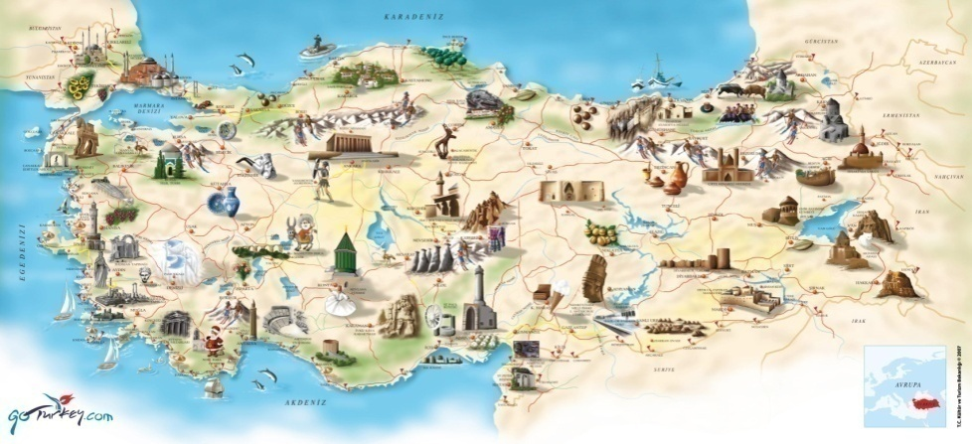
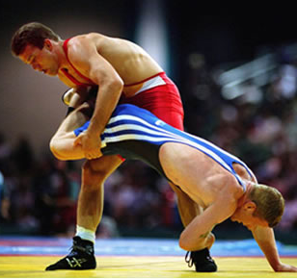
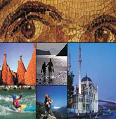
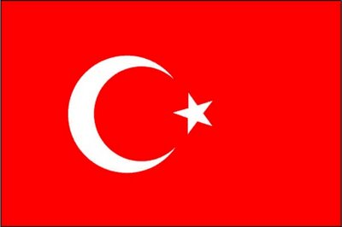
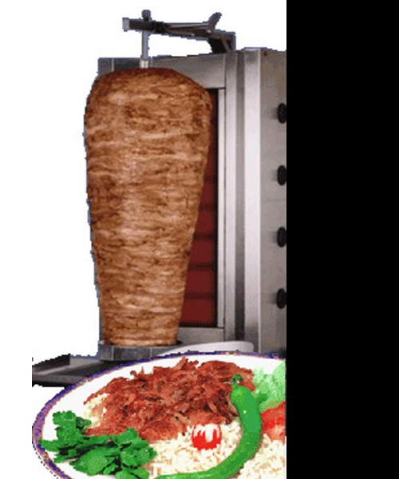
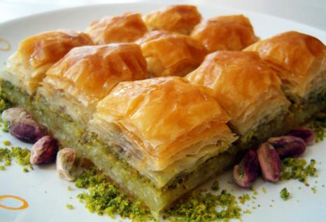
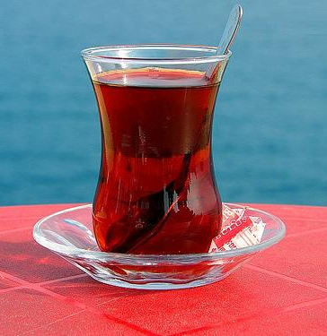

Welcome to
Turkey
Turkey

Slide 2
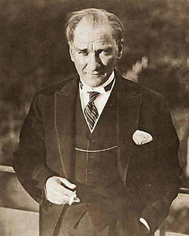
‘Peace at Home, Peace in theWorld’
Mustafa Kemal Atatürk is the founder and first President of the Republic of Turkey

Slide 3
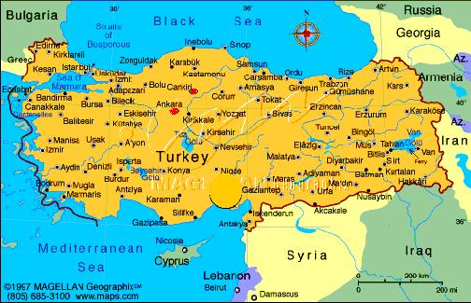
Turkey is bordered by eight countries: Bulgaria to the northwest; Greece to the west; Georgia to the northeast; Armenia, Azerbaijan and Iran to the east; and Iraq and Syria to the southeast.

Slide 4
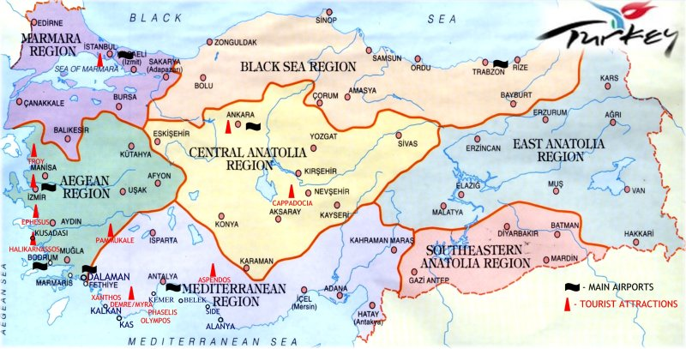
Turkey-Regional

Slide 5
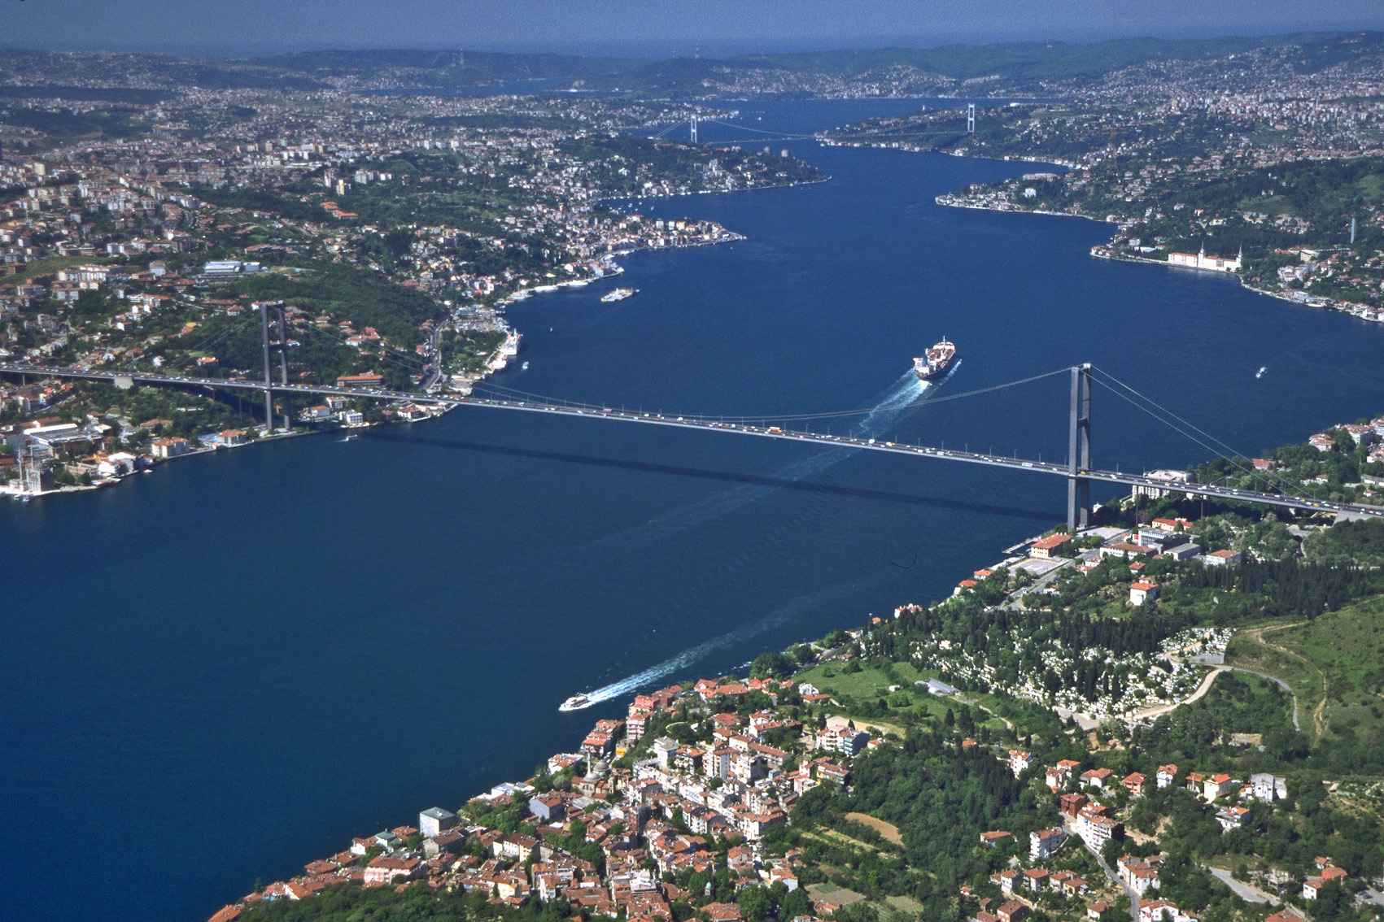
        Turkiye is a gateway between Europe and Asia continents, The European and Asian sides are divided by the Istanbul Boğazı (Bosphorus),

Slide 6
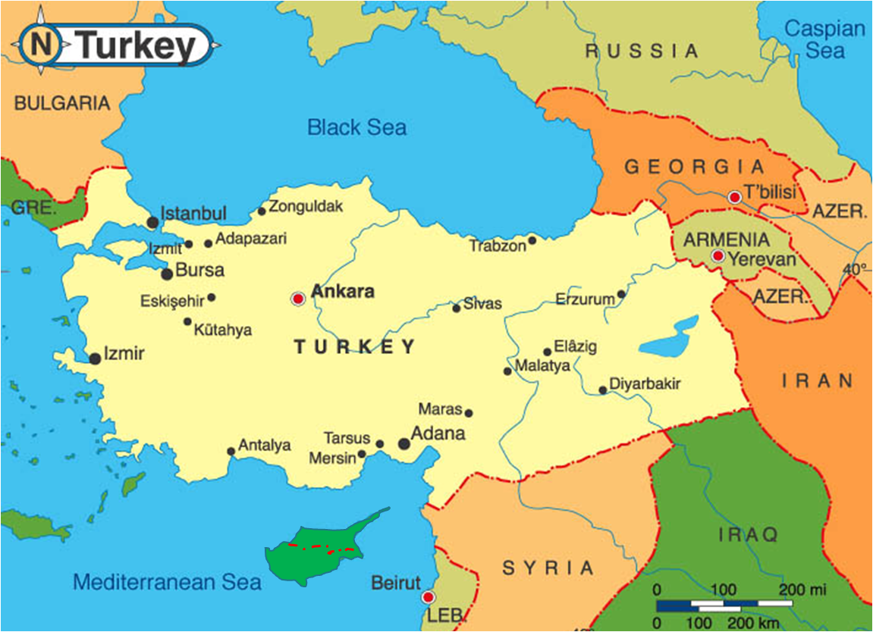
The country is encircled by seas on three sides: the Aegean Sea to the west, the Black Sea to the north and the Mediterranean Sea to the south

Slide 7
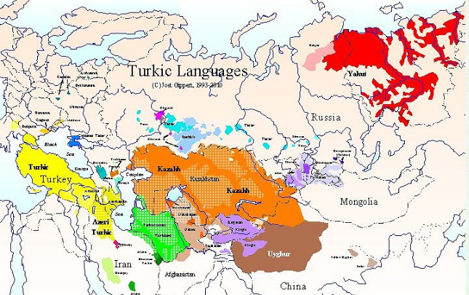
Language
The official language of the country, Turkish is spoken by 220 million people and is the world's 5th most widely used language.

Slide 8
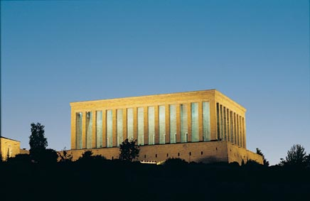
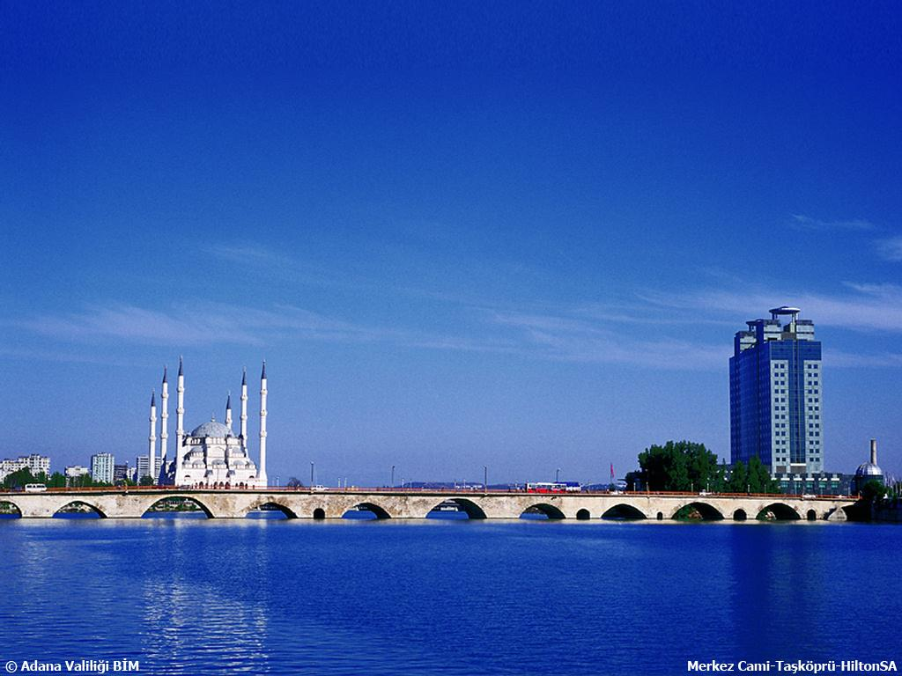
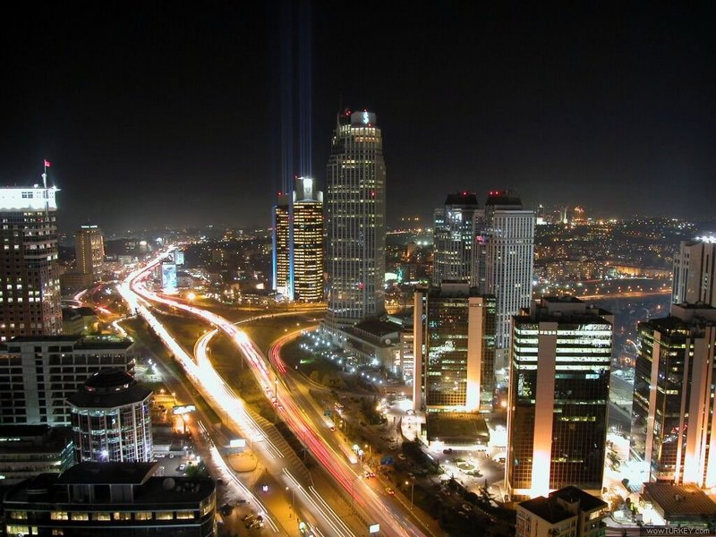
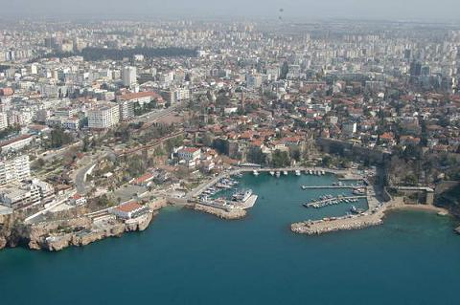
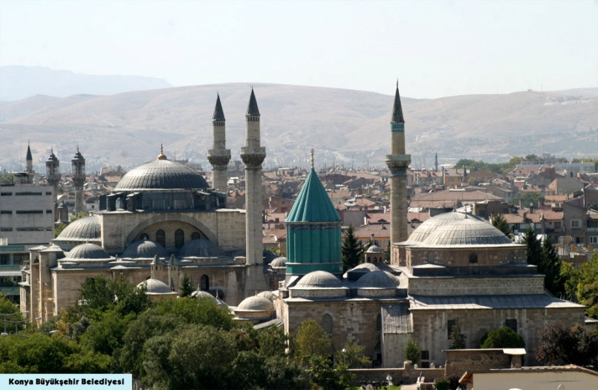
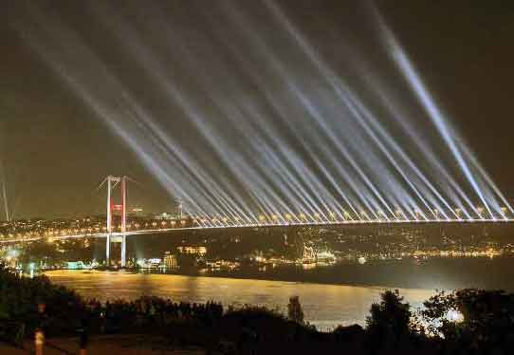
Ankara is the capital city of Turkey
Istanbul, Ankara, Izmir, Adana, Antalya are the largest cities in Turkey

Slide 9
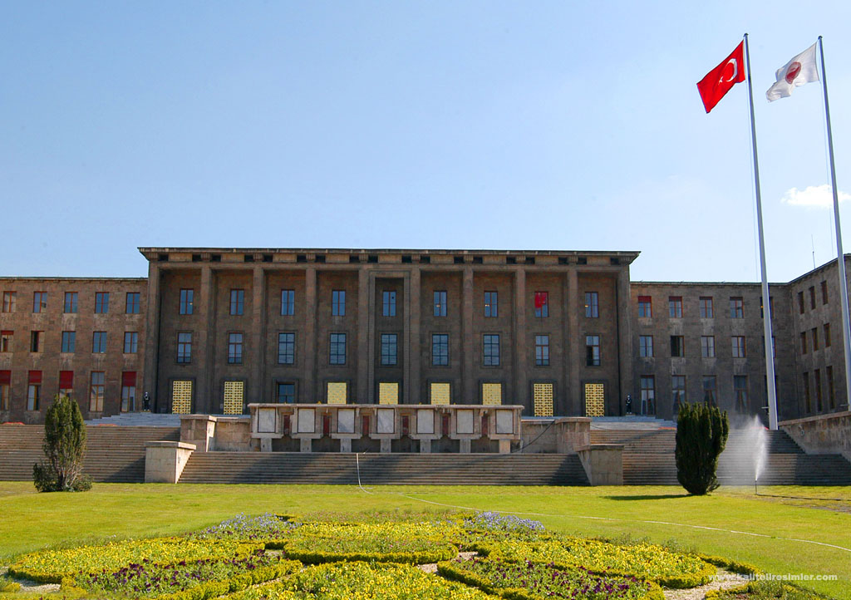
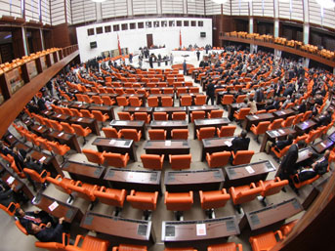
Politics
Democratic,
Secular,
Unitary,
Constitutional republic.
Separation power.
Political rights to women in 1934

Slide 10
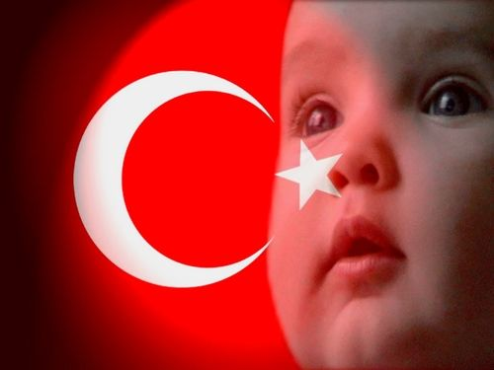
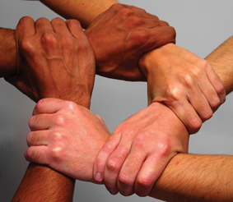
Demographics
Population : 75 million
Growth rate : 1.2 %
Age structure
  0-14 years : 25.5 %
  15-64 years : 67.7 %
  65-over : 6.8 %

Slide 11
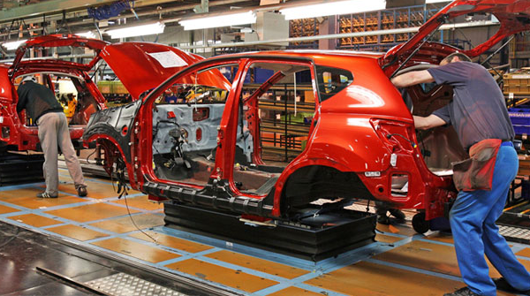
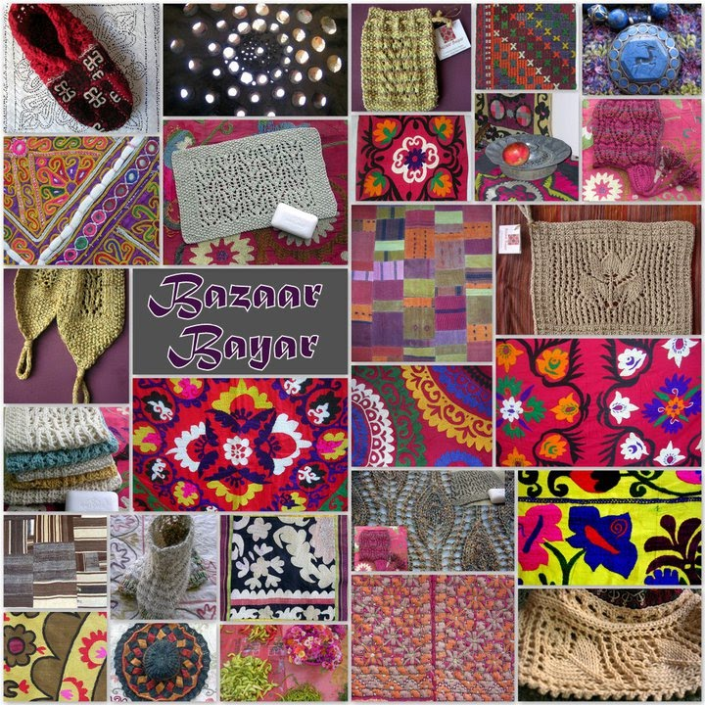
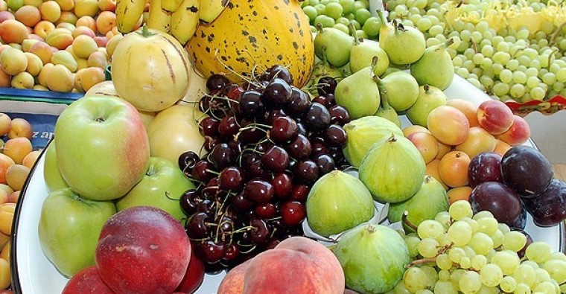
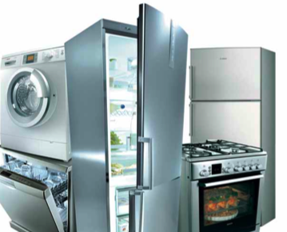
Economy
16th largest economy in the world
Textiles
Vehicles
Agricultural products
Consumer electronics

Slide 12
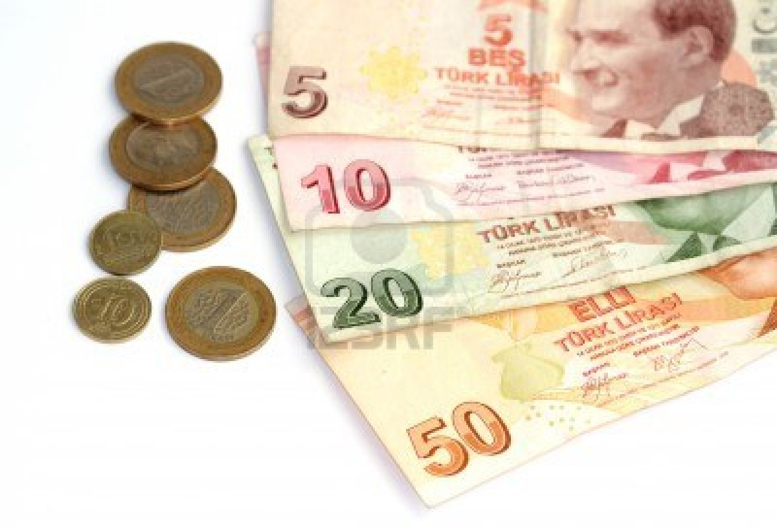
The currency of Turkey is Turkish Lira

Slide 13



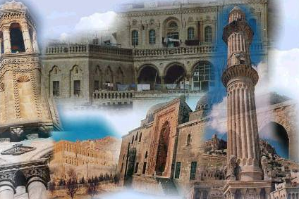








Tourism
Hunting
Rafting
Winter Sports
Culture
Silk Road
Thermal Resorts
Golf
Ornithology
Yachting
Botanic
Highlands
Air Sports

Slide 14
THANK YOU FOR LISTENING
Prepared by
Seher TÜRKHAN EREN ☺

